Slide 1
By: Julia Nnoko

Slide 2
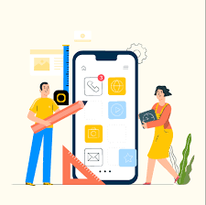
What is Pharm2U?
Pharm2U was designed to create a user friendly app that is able to deliver medications to the user’s house upon users request.
Pharm2U was designed for all target populations

Slide 3

Success Measurements
95% of users will be able to create an account using their personal information.
99% of users will be able to find the nearest pharmacy location to them in 60 seconds.
The goal is achieve an overall rating of 97%.

Slide 4
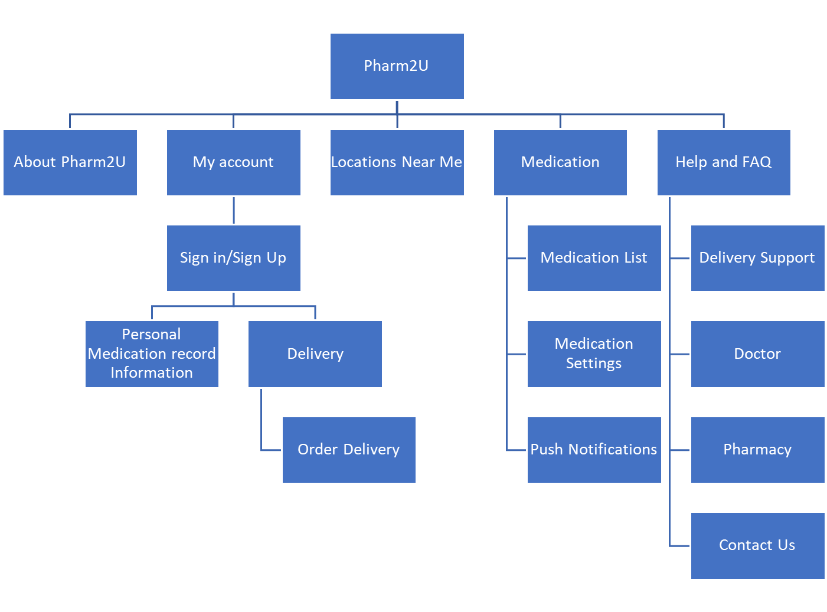
Stakeholder’s Map and Site Structure
Doctors
Pharmacists
Patient
Delivery drivers

Slide 5
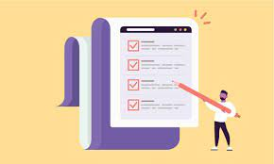
Task List
Mona wants to sign into his account.
Mona wants to create an account.
Mona needs to update her address.
Mona needs to order a delivery.
Mona needs to change her delivery and schedule for later.
Mona has a question and needs the Pharm2U contact information.
Mona needs to access the frequently asked questions.
Mona needs to search for the closest pharmacy near her.
Mona forgot the contact information to her doctor and needs to access it.
Mona moved and needs to update her pharmacy and doctor information.

Slide 6
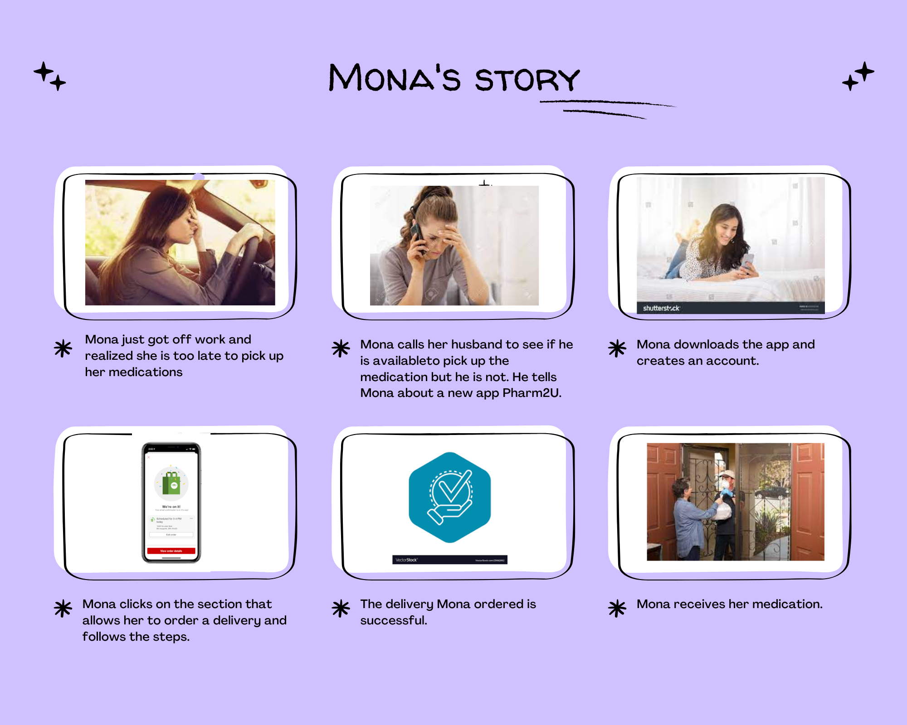
Storyboard

Slide 7
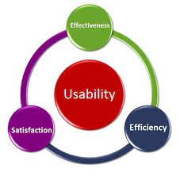
Function/ Feature Design
Create account: This is a key feature which will allow users to follow a three-step process which includes providing personal medication list, and delivery information.
Order delivery: This is a key feature which will allow users to follow a two-step process which includes selecting tip for the driver.
Push Notifications: This is a key feature which will allow users to get notified via SMS notifications.

Slide 8
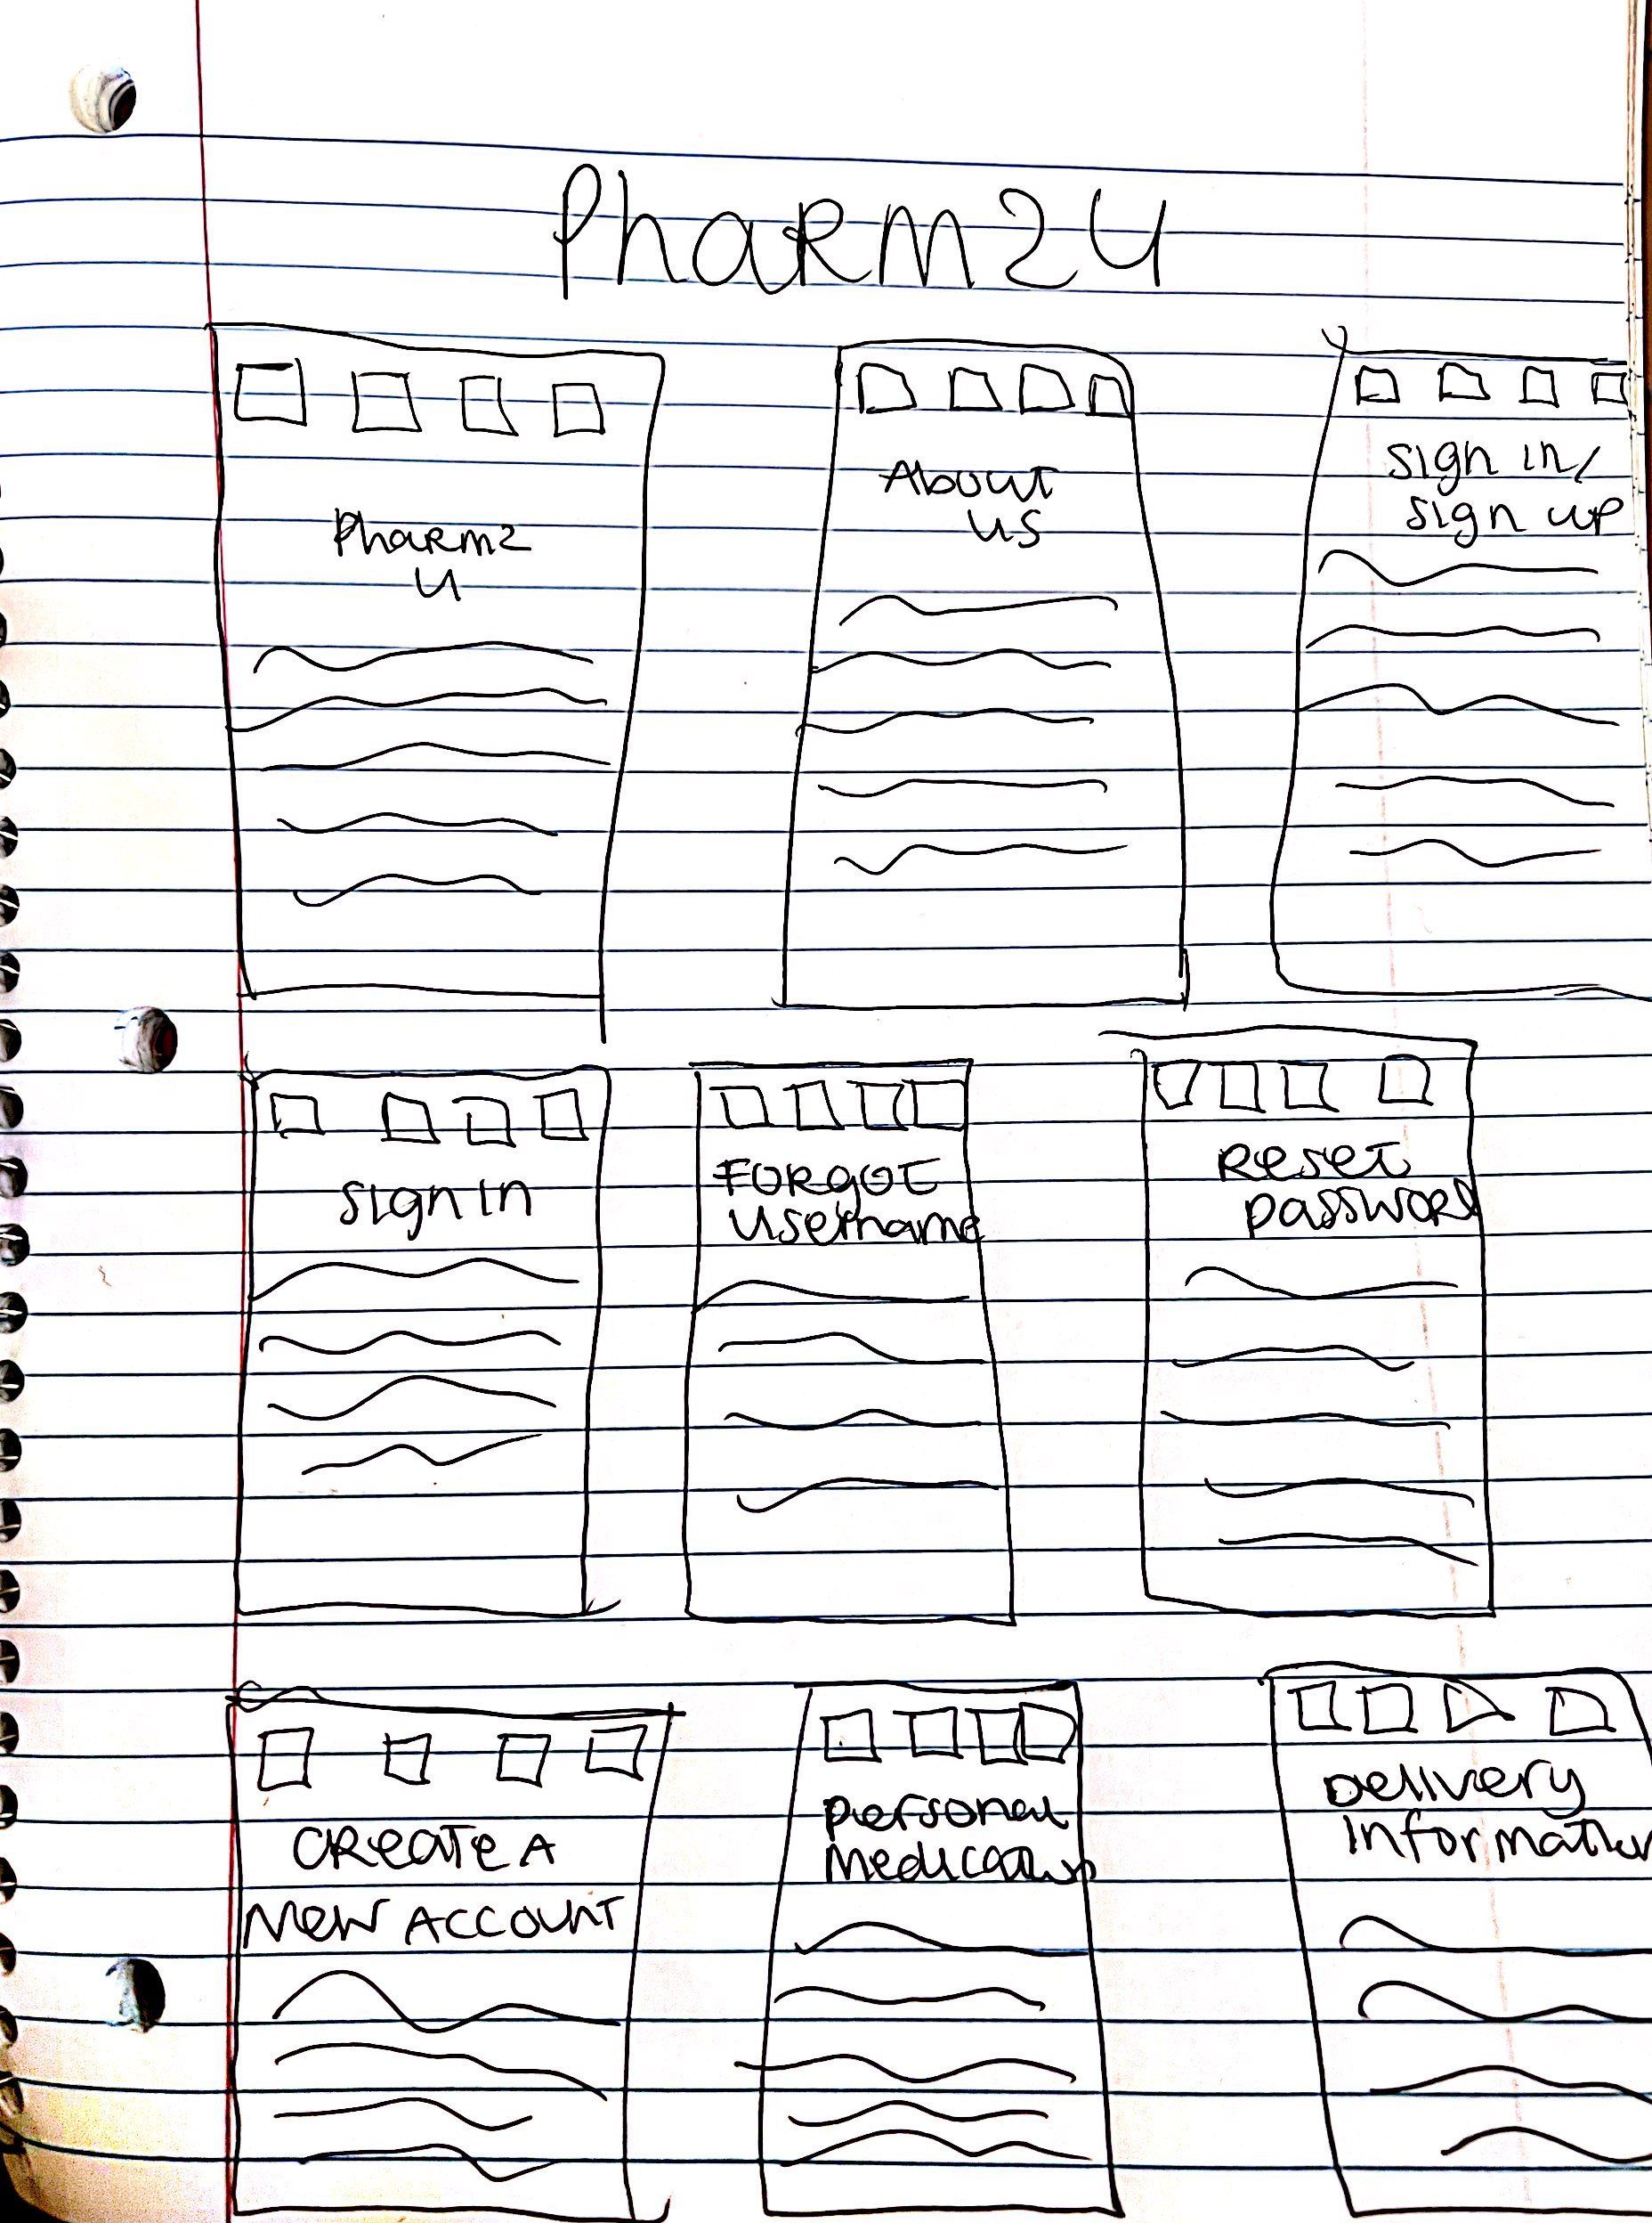
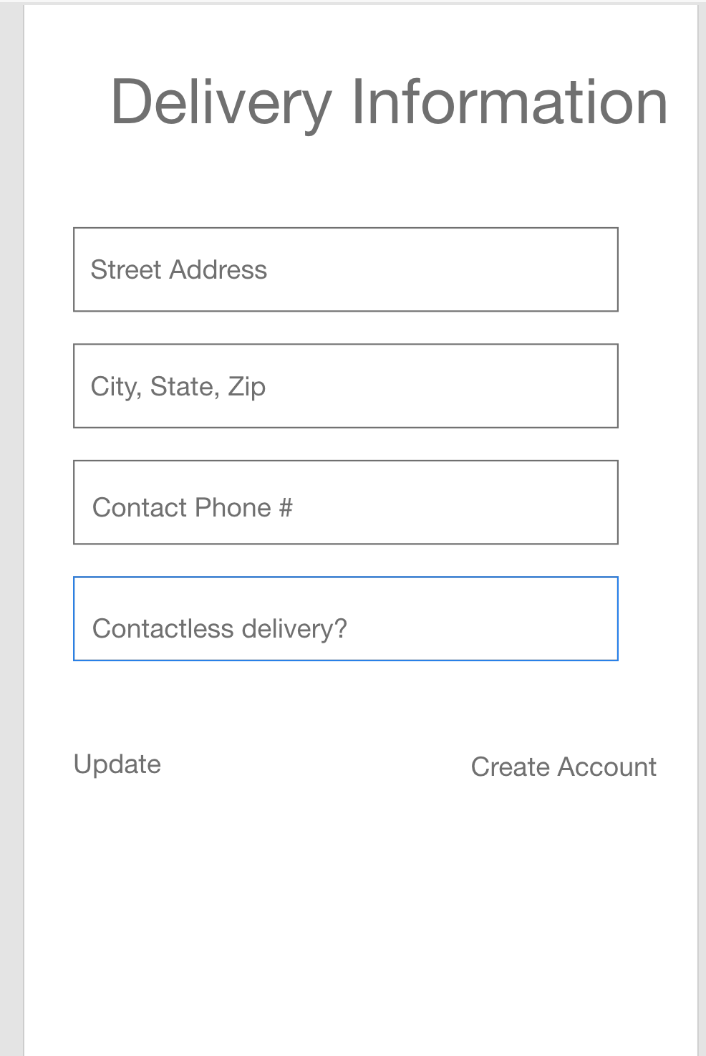
Prototype 1
Pencil-paper prototype
Interactive prototype

Slide 9
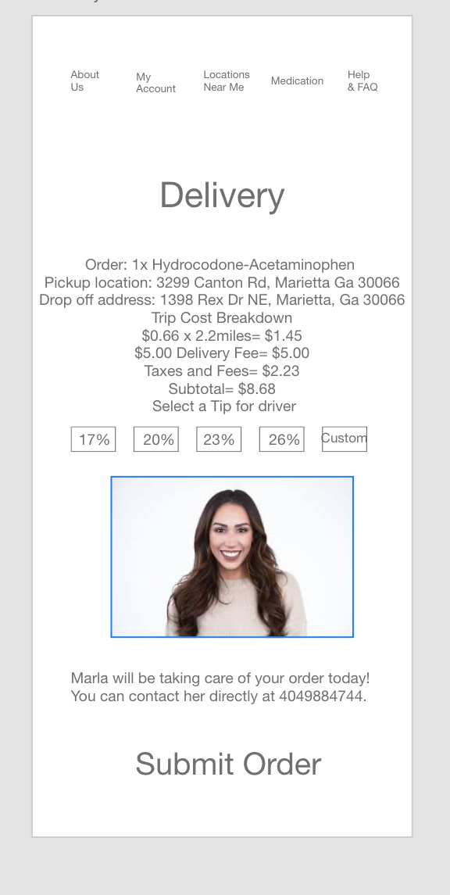
Prototype 2/ Testing

Slide 10

Conclusion
Pharm2U is an interactive prototype which focuses on user friendly buttons to assist with the delivery process of medications.
Pharm2U is targeted to help people of all ages, gender, and ethnicity tackle an activity that always seems so hard to complete.
This is the first step of the design, I plan to continue to make improvements to Pharm2U.

